Slide 1
Quick Review
Margin trading
Margin buying
Margin short-selling
Initial margin, maintenance margin and margin call
Borrowing increases both upside and downside returns.
Margin = Equity/ Value of stocks

Slide 2
Return and Risk

Slide 3
Objectives
Concepts of return and risk
Calculate return and risk
Concepts of real return
Historical evidence on the relation between risk and return
Concepts of risk averse

Slide 4
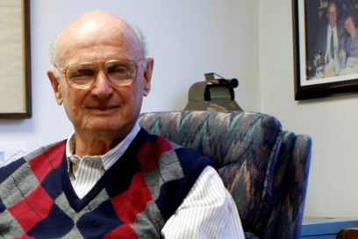
Portfolio Selection, The Journal of Finance, 1952

Slide 5
Modern Portfolio Theory
Harry Markowitz (Nobel Winner, 1990)
He noticed the lacks of analysis of risk in theory.
He applied statistical concepts to study the effects of asset risk and return, and to solve investment problems.
His theories totally changed the practices of professional investment.
Modern Portfolio Theory: Maximize portfolio expected return for a given amount of portfolio risk, or equivalently minimize risk for a given level of expected return.
Prove mathematically the best possible diversification strategy.

Slide 6
General Perception on Risk and Return
A broker tells Peter, “ if you buy Stock XYZ, you will earn 10% under normal circumstances.”
This means expected return
Peter asks, “What is the chance for this return?”
This implies the realization of uncertainty or risk.
The broker says, “Well. It is hard to say. The probability for this return is around 70%.”
Peter asks, “How much will I lose if this does not occur?”

Slide 7
General Perception on Risk and Return
This conversation reveals conceptually the following items:
Expected return
Uncertainty involved
Probability of return outcomes
Extent of loss in undesirable outcomes

Slide 8
What are Returns?
When we speak of “returns”, we always mean holding period returns (HPR).
Stocks: capital gain plus dividend yield
Bonds: capital gain plus current yield
E.g.:
Suppose,
P₀ = Beginning price = $40
P₁ = Ending price = $48
D₁ = Dividend (coupon payments) paid during period 1= $ 2
then,

Slide 9
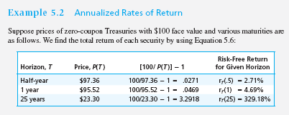
Rates of Return for Different Holding Periods
Zero Coupon Bond, Par = $100, T = maturity, P = price, r_{f}(T) = total risk-free return
100-P(T)
P(T)

Slide 10
Rates of Return for Different Holding Periods
EAR definition: percentage increase in funds invested over a 1-year horizon
1+ EAR = (1.0271)² = 1.0549, EAR = 5.49%
1+ EAR = (4.2918)^{1/25} = 1.060, EAR = 6.0%
Horizon, T | Risk-Free Return for Given Horizon | EAR
Half-year | r(0.5) = 2.71% | 5.49%
1 year | r(1) = 4.69% | 4.69%
25 year | r(25) = 329.18% | 6.00%

Slide 11
Expected Return – Looking Ahead (Scenario or Subjective Measure)
p(s) = probability of a state
r(s) = return if a state occurs
possible states: 1 to s

Slide 12
Expected Returns: Example
State of economy Probability Return r in state
1. Very bad 0.10 -0.05
2. Bad 0.20 0.05
3. Average 0.40 0.15
4. Good 0.20 0.25
5. Very good 0.10 0.35
E(r) = 0.10×-0.05 + 0.20×0.05 + 0.40×0.15 + 0.20×0.25 + 0.10×0.35
E(r) = 0.15

Slide 13
Estimate E(r) Using Historical Data – Looking Back
Arithmetic Average:
Geometric Average:
Using the following numbers to calculate arithmetic/geometric average:
Year Return
1999 6.8%
2000 5.5%
2001 -3.2%
2002 2.6%
2003 7.7%

Slide 14
Estimate E(r) Using Historical Data – Looking Back
You invest $1000 in a zero coupon bond for one year and earn a return of 5%. You then reinvest the proceeds at 20% for a second year. How do you describe your average annual return over the two year period ?
HPR = [1,000 × (1+5%) × (1+20%) - 1,000] / 1,000
= 26%
EAR = (1+HPR)^0.5 = 12.25%
Geometric average = [(1+5%)(1+20%)]^0.5-1 = 12.25%

Slide 15
Inflation and Real Returns
Historically (after 1926) the inflation rate has been about 3%.
Fisher effect: Assume i = inflation, then
You invest $1,000 in a stock with a one-year return of 8%. The one-year inflation rate is 2%. What is the stock’s real return rate?

Slide 16
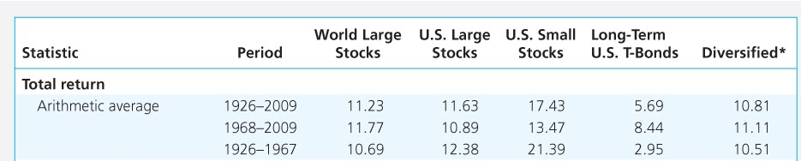
Historical Returns

Slide 17
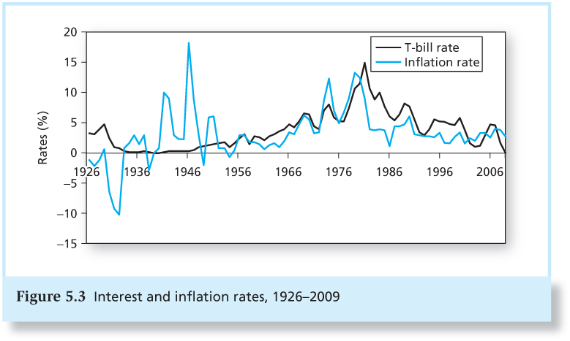
T-Bill and Inflation

Slide 18
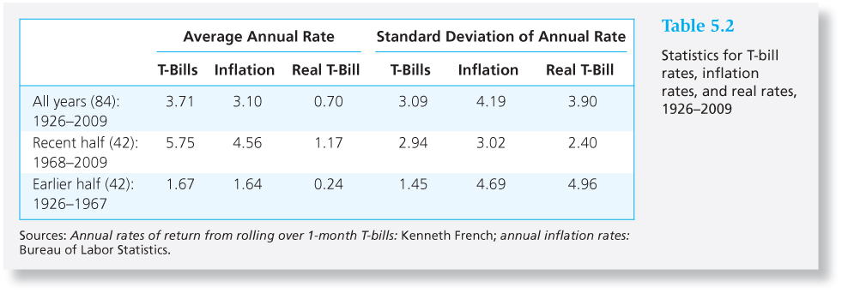
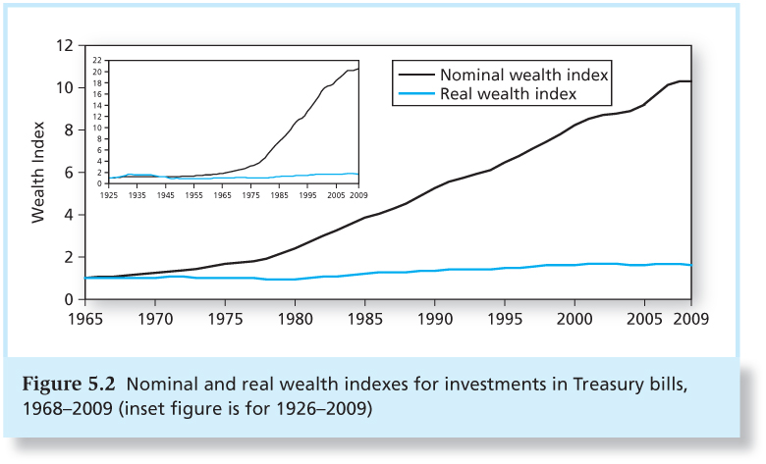
T-Bill and Inflation

Slide 19
Return Differences
Return differences between stocks and bonds
From 1926-2009 stocks outperformed T-bills by over 6% a year.
Why would anyone invest in bonds/bills instead of stocks?

Slide 20
Risk -- Looking Ahead (Scenario or Subjective Measure)
Risk: the uncertainty of a return and the potential for financial loss
Measuring risk: Standard deviation (σ) is the most commonly used measure.
Using numbers in the previous example:
= [0.1×(-0.05 - 0.15)² + 0.2× (0.05 - 0.15)²...+ 0.1× (0.35 - 0.15)²]
= 0.01199
= (0.01199)^{1/2} = 0.1095

Slide 21
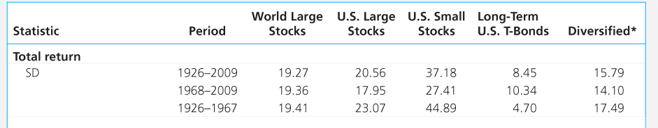
Estimate σ - Looking Back
We use sample estimates as approximations for the true variances and standard deviations.
Notice division by n-1 rather than n with historical data.
Historical σ:

Slide 22
How Do Investors View “Risk”? – More examples
Consider the following investment options
Option A: Invest $1,000 today and receive $1,100 after one year with certainty
Option B: Invest $1,000 today and one year later toss a coin:
If Heads, receive $2,000
If Tails, receive $200
Which option would you prefer?

Slide 23
Why?
Expected return:
Option A: E(r) = (1100 - 1000)/1000 = 10%
Option B: Expected payoff = 0.5×(2000) + 0.5× (200) = $1100. E(r) = (1100 - 1000)/1000 = 10%
Risk:
Option A: σ = 0
Option B: σ = sqrt[0.5× (1 - 0.1)² + 0.5× (-0.8 - 0.1)²] = 90%

Slide 24
Another Set of Choices
Option A: Invest $1000 today and receive $1100 after one year with certainty
Option B: Invest $1000 today and one year later toss a coin:
If Heads, receive $2000
If Tails, receive $400

Slide 25
What are the expected rates of return and σ now?
Expected Return:
Option A: E(r) = (1100 - 1000)/1000 = 10%
Option B: Expected payoff = 0.5(2000) + 0.5(400) = $1200. E(r) = (1200 - 1000)/1000 = 20%
Risk:
Option A: σ = 0
Option B: σ = sqrt[0.5(1 - 0.2)² + 0.5(-0.6 - 0.2)²]= 81%

Slide 26
Suppose option B was modified as:
Option B: Invest $1000 today and one year later toss a coin:
If Heads, receive $2000
If Tails, receive $800

Slide 27
What can we learn from the responses?
Rate of return in option A is risk free.
Investors are generally risk averse.
For example, given the same return and different risk alternatives, we will seek the asset offering the least risk.
Risk averse investors require a risk premium to induce them to invest in risky assets
The difference between the expected return and the risk-free rate.
consistent with historical returns

Slide 28
Risk Premium and Excess Return
Risk premium is the reward for bearing risk. It is the difference between the expected return and the risk-free rate.
Excess return is the difference between the actual rate of return and the risk-free rate.

Slide 29
Key Question
What is the required risk premium for a given asset?
Risk of the asset: Is σ a good risk measure?
Investor risk aversion (or tolerance): How to assess the degree of risk aversion?

Slide 30
Is σ a good risk measure?
Characteristics of probability distributions:
Mean
Most likely value (expected value)
Variance or standard deviation (volatility)
Degree of deviation from the mean value
Skewness
Degree of asymmetry in distribution
Kurtosis
Degree of fatness in tail area
Others …

Slide 31
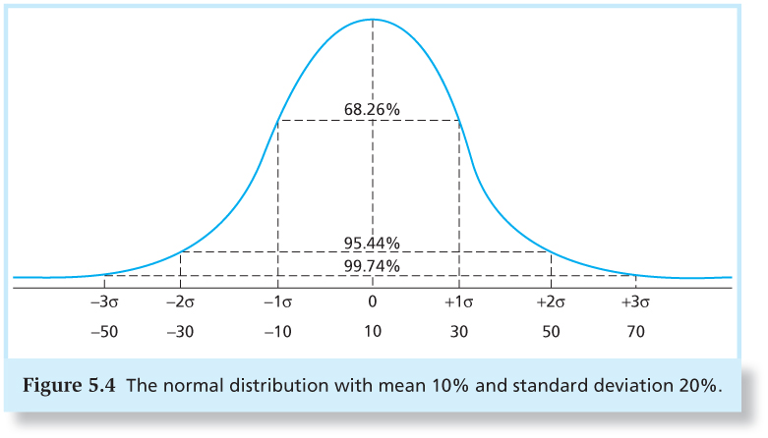
Normal Distribution
Bell shaped distribution. The upward potential is the same as the downward risk, and the expected value is the same as the arithmetic mean - - symmetry
If a distribution is approximately normal, the distribution is described simply by characteristics 1) mean and 2) σ .

Slide 32
Deviations from Normality
Left-skewed distribution
Large negative returns possible
Big losses are more likely than big gains
Right-skewed distribution
Large positive returns possible
Big gains are more likely than big losses
(Underestimate risk)
(Overestimate risk)
Negative
Positive

Slide 33
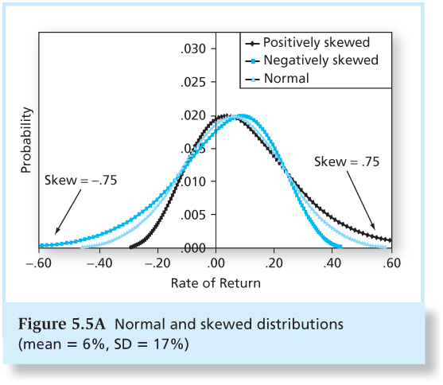

Slide 34
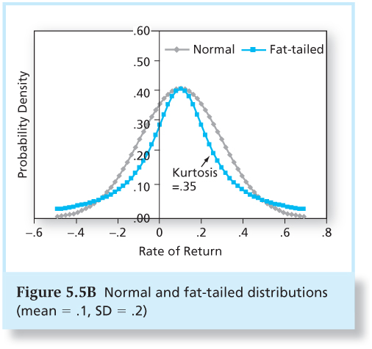

Slide 35
Deviations from Normality – σ might not be a good risk measure
Investors are concerned about downside risk.
Standard deviation includes both the above-average returns (upside risk) and the below-average returns (downside risk). If returns are skewed, standard deviation is not the only relevant measure of risk.
Holding expected return and standard deviation constant, investor would prefer positive skewed distribution.

Slide 36
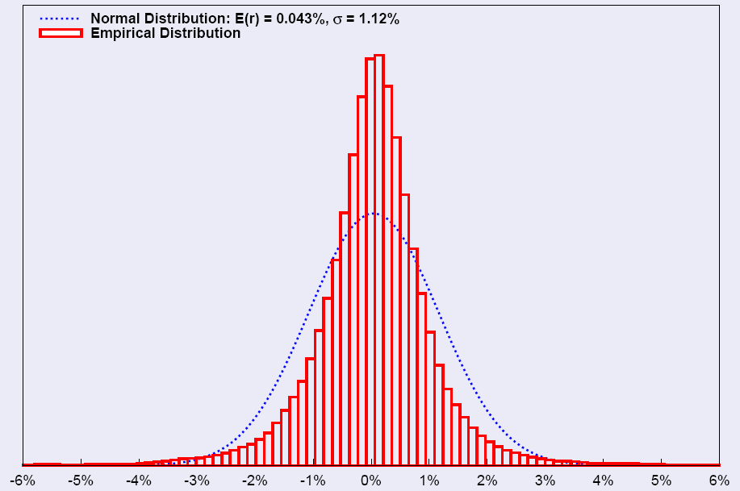
Daily S&P 500 Return : 1926 - 2007

Slide 37
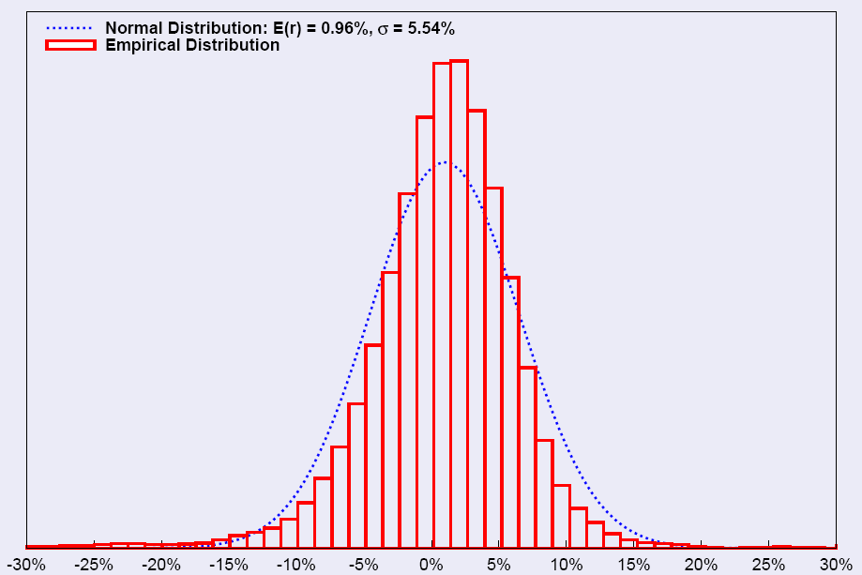
Monthly S&P 500 Return : 1926 - 2007

Slide 38
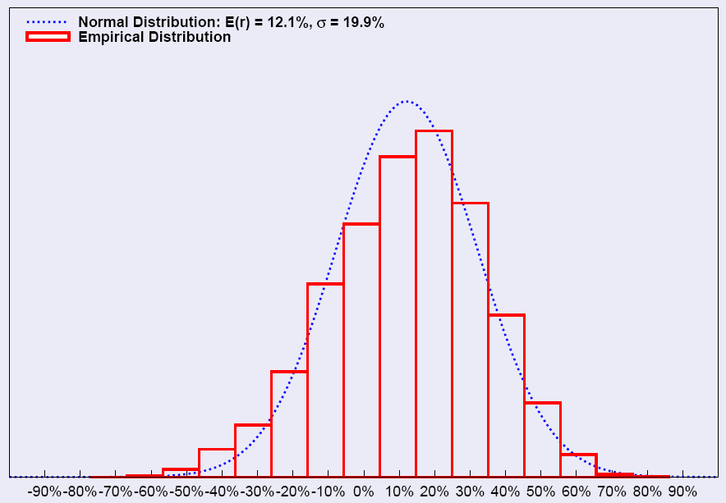
Annual S&P 500 Return : 1926 - 2007

Slide 39
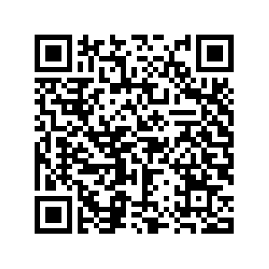
How to assess the degree of risk aversion?
Risk Tolerance Quiz

Slide 40
How to assess the degree of risk aversion?
1. A month after you purchase a stock its share price rises by 50%. You can’t find out why it rose so dramatically, what would you do?
Buy more, it may go higher.
Hold on to what you have hoping for a further gain.
Sell it immediately
 | (a)4 | (b)3 | (c)1

Slide 41
How to assess the degree of risk aversion?
2. You go to Macau with friends and lose the $2,000 you had allocated for gambling. What do you do?
Quit gambling and enjoy the other activities.
Decide $1,000 more may just win your $2,000 back.
Notice that one of your friends lost $5,000 before winning it all back and allocate another $2,000.
Throw caution to the wind, the more you lose the better the chances of winning!
 | (a)1 | (b)2 | (c)4 | (d)9

Slide 42
How to assess the degree of risk aversion?
3. You are on a TV game show and must decide whether to go on or take your $50,000 winnings and quit
Take the money and run.
Take a 20% chance of losing it all but winning $250,000.
Take a 50% chance of losing it all but winning $375,000.
Take a 90% chance of losing it all but winning $500,000.
 | (a)1 | (b)4 | (c)6 | (d)9

Slide 43
How to assess the degree of risk aversion?
4. Your best friend wants to start a new business but she needs some capital for startup costs. You think her new business idea has real potential. She wants you to invest $40,000 (which you currently have), in return you would own 30% of her company. If everything goes as planned, you could get back 40 times your investment in three years, on the other hand four out of five small businesses fail within the first three years. What would you invest?
Nothing at all and wish her well.
Tell her you will work with her and try to get financing through some conventional means. Invest no money.
Invest $20,000.
Invest the $40,000 and if things seem to be going well tell her there is more where that came from.
 | (a)1 | (b)2 | (c)4 | (d)9

Slide 44
How to assess the degree of risk aversion?
5. What would you be more excited about:
You win $5,000 by being the 15th caller on a radio show.
Your grandmother sends an unexpected gift of $5,000.
A risky $500 investment you made last year returns $5,500.
$5,000 is $5,000 – you’re excited, no matter how it came to you!
 | (a)2 | (b)1 | (c)6 | (d)1

Slide 45
Risk Preferences
17 points and over: Risk Seeker/Acceptor
The closer you are to 37 points the more adventuresome investor you are.
8-16 points: Risk Minimizer/Middle of the Road
You are willing to take calculated risks with your investments and realize the need for diversity.
Below 8: Risk Avoider
You are conservative in your investment philosophy. If you don’t develop some tolerance for investment risk your biggest risk will be inflation. As you develop the confidence or desire to take on more investment risk, go slow.

Slide 46
What factors can affect the risk aversion?
Wealth
Gender
Education
Marital Status
Family size
Age
Prior experience
Other factors…

Slide 47
Equity Premium Puzzle
Historically, r_{stock} − r_{t-bill} ≈ 6%
It’s called Equity Premium.
Many economists think 6% is too big.
Yes, economists agree that stocks are riskier.
But not risky enough to justify 6% per year.
It is a puzzle—given the historical return data—why everyone isn’t holding 100% stocks and 0% bills or bonds.

